Slide 3
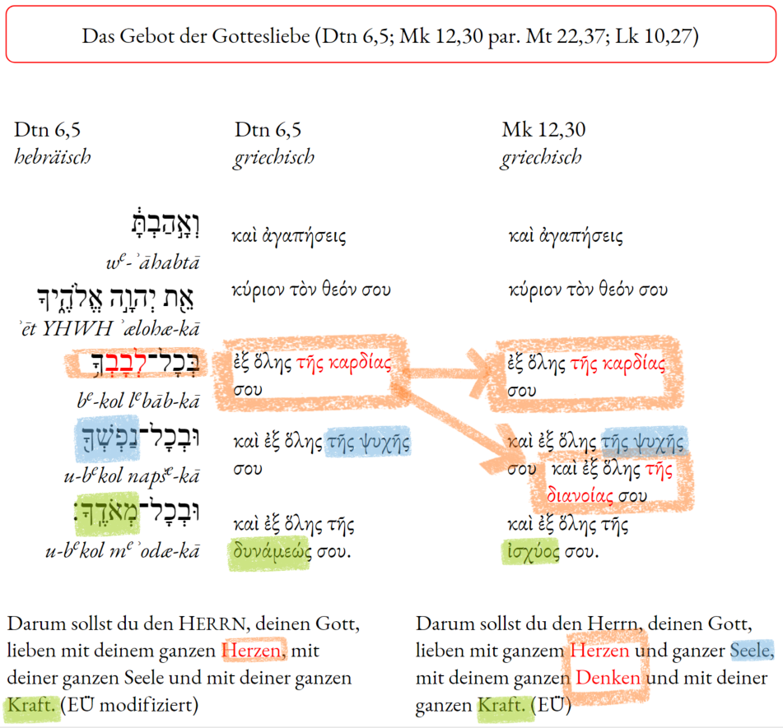
© Thomas Hieke

